Slide 1

Automated Task Assignment system
Sue Byeon
Dec. 2, 2025
Notes:
30 sec – introduction
Hello good morning good afternoon and good evening! thank you everyone for joining me here today for my final capstone presentation. My name is Sue Byeon. I am the lead project manager, developer, analyst on this project. I am excited to share with you guys what Ive been working on over the past 10 weeks: an automated task assignment algorithm specifically for the telecom industry. What makes this project unique is that it focuses on matching tasks to technicians based on their individual strengths and capabilities.
So now Lets get into it!

Slide 2
Problem Statement
Misaligned Technician Assignments
Lost Trust & Dissatisfaction
Advanced Network Technology
Losing $2.09 billion/year from churn*
Customers rely on fast, reliable connections for work, school, and social life.
Great Product, Poor Experience
* For a company with 100,000 customers, 30% annual churn rate, and ARPU of $69,690
Notes:
1 min
Now, let’s talk about why this project matters.
In today’s world, people have an undeniable desire to stay connected. Telecom companies play a huge role in this by providing the high-speed connectivity we all depend on for work, school, and staying in touch with friends and family. But here’s the challenge—while customers expect fast and reliable connections, many providers struggle to offer that same quality when it comes to their field services. The main reason? They’re often stuck using outdated task assignment systems.
So, even if you have a great product, you can end up delivering a poor experience to your customers.
To put this into perspective, imagine a company with 100,000 customers. If they have a 30% annual churn rate and an average revenue per user of $70K, that company could lose around $2.09 billion each year—simply because customers are dissatisfied with poor service.

Slide 3
Current State Analysis & Metrics
Task request
Dispatcher assigns manually
Relies on availability or location only
Frequent mismatches
Task execution
Outcome
Customer frustration
Technician frustration & burnout
Customer schedules technician service requests
Technician assigned randomly
58%
Expertise Match Rate
58%
Task Completion Rate
$16.8K
Total Penalty Cost for Delays
3.06
Customer Satisfaction Score
Notes:
1.5 min
In fact, let me show you what the current scheduling process actually looks like, and why it’s creating real inefficiencies across the operation.
Right now, dispatchers assign tasks manually. They usually go by whoever’s available or closest to the job—not necessarily by who has the right skills or expertise. As a result, only about 58% of incoming tasks actually get matched to a technician who’s fully qualified for that job.
This mismatch has a direct impact on our results. When technicians are assigned tasks outside their skill set, our first-time completion rate drops to just 58%. In other words, more than 4 out of 10 tasks require a second visit, which increases the workload and throws off the daily schedule.
There’s also a clear financial cost. So far, the business has taken on about $17,000 in penalty costs just because of rework. Every failed job means dispatching another technician, which adds extra labor, travel, and customer follow-up expenses.
From the technician’s perspective, it’s frustrating—they’re often given tasks they aren’t fully prepared for, which can really hurt morale. And customers are feeling it too. Our current customer satisfaction score averages just 3.06 out of 5, so we know the experience is already being impacted.
So, that’s where we’re starting: a manual assignment process, low match accuracy, high rework, and added pressure on the business, our employees, and our customers.

Slide 4
Risks of Inaction
Financial
Rework costs from failed assignments
Revenue loss due to missed SLAs and churn from dissatisfied customers
Operational
Inefficient scheduling → technician idle time and misallocations
Increased turnover and burnout
Decline in customer trust and satisfaction scores
Risk of negative reviews, regulatory scrutiny, or union action
Inability to scale and lose industry competitiveness
Stagnant service capacity
Reputational
Notes:
1 min – why it matters
So, now that we’ve seen where things stand today, the bigger question is: what happens if we don’t make any changes?
The risks actually pile up in three major areas—financial, operational, and reputational.
Let’s start with the financial impact. If we keep things as they are, the organization will keep absorbing costs from rework. Every time a job isn’t done right the first time, it means sending out another truck, spending more on labor, and sometimes even paying overtime. Plus, when we miss service level agreements and customers aren’t happy, that translates directly into lost revenue. Over time, we also miss out on chances to scale the business efficiently, which means losing out to competitors and passing up market opportunities.
Operationally, the scheduling process stays inefficient. Tasks will continue to land with the wrong technicians, so some people end up overloaded while others are left waiting around. That kind of imbalance leads to burnout and higher turnover—which comes with its own costs when you factor in hiring and training new staff. And with limited capacity, it becomes harder for the organization to grow without sacrificing service quality.
Finally, there’s reputational risk. Customer satisfaction is already under strain, and if things don’t improve, we risk eroding trust even further. That can lead to negative reviews, loss of customer loyalty, and in some cases, even regulatory attention or union concerns if working conditions aren’t addressed.
So, the risk of doing nothing isn’t just about staying where we are—it actually means letting these financial, operational, and reputational problems grow bigger over time.

Slide 5
Technical Solution Overview
Automated Task Assignment System
Improved UI
Automation
Robust Database & Pipeline
ML Matching Algorithm
Faster & Smarter Decisions on Assigning Technicians
Notes:
30 sec
So, how do we tackle these challenges? The solution I’m proposing is an automated task assignment system designed to boost accuracy, efficiency, and the overall quality of service.
Here’s how it works:
First, we start with a solid foundation—a robust database and data pipeline. This setup continuously brings in clean, organized data about both tasks and technicians. That way, the system always has up-to-date, reliable information to make decisions.
Next, at the heart of the solution is a machine learning matching algorithm. This model looks at things like past performance, technician expertise, and the specific details of each task to predict which technician is the best fit for the job. So, instead of relying on gut instinct or manual assignments, we’re making data-driven decisions.
We’ve also completely redesigned the user interface to make it more intuitive for both dispatchers and field teams. It’s now easier to see which technicians are available, review any unassigned tasks, and even understand why the system is recommending certain matches.
And finally, automation steps in. Rather than dispatchers having to scroll through endless lists, the system can instantly recommend—or even automatically assign—the right technician for each job in real time. This cuts down decision-making time, reduces errors, and keeps jobs moving forward without unnecessary delays.
When you put all these pieces together, the result is clear: faster, smarter technician assignments that set us up for success.

Slide 6
Data overview
historical_tasks
Task ID (PK)
Technician ID (FK)
Task Distance
Task Priority
Task Complexity
Equipment Required
Customer Rating
Penalty Cost
Expertise Match
Task Completed
N
N
unassigned_tasks
Task ID (PK)
Task Distance
Task Priority
Task Complexity
Equipment Required
Customer Rating
Penalty Cost
Worked
Assign
1
1
technicians
Technician ID (PK)
Eqpt Trained
Tech Complexity
Notes:
1 min
Let me walk you through how I got started with the data.
I began with two datasets that I sourced from Kaggle. The first one covered task assignments and completion records for field technicians—basically, each row represented a unique task, along with details about the task and how well it matched the technician’s skills. The second dataset focused on completed assignments and their outcomes, including details like operational logistics, what each task required, and how customers rated the results.
To make sense of all this raw data, I transformed everything into a clean, organized structure with three key tables: Technicians, Historical Tasks, and Unassigned Tasks, which you can see in the ERD. Each technician can be linked to multiple completed or incoming tasks—so one technician might have worked on several jobs and could be assigned to many more. This setup lets us connect someone’s past performance directly to their future assignments, and it keeps the data organized for predictive modeling.
I also want to highlight a few key fields that I engineered for this project—like Penalty Cost and Expertise Match on historical_tasks table and Eqpt Trained and Tech Complexity in technicians table. These new features became important drivers for the model. The original datasets lacked broader context of the technician’s skills and distinct factors to merge on. Without those, it would have been hard for the model to really understand the real-world relationships at play.
By creating these engineered fields, I was able to give the model more meaningful information to work with, which laid a strong foundation for the predictive work that comes next.

Slide 7

Data Preparation
Are you QUALIFIED or not
Join
Imputation
Feature Engineering
Task Complexity
Penalty Cost
Based on the task techs have worked on, what does it say about their skillset?
Eqpt Required
Customer Rating
Based on Task Priority
Create Eqpt Trained + Tech Complexity
Recalibrate Expertise Match
Expertise Match + Eqpt Required + Task Complexity
Assumption: Expertise Match looks at equipment requirement and complexity level
Are you QUALIFIED or not?
Notes:
1 min
“For the data preparation phase, I focused on three major steps to get the datasets ready for modeling: joining the tables, imputing missing values, and engineering new features.
First, joining the datasets:
The two original Kaggle tables each captured different parts of the story. One focused on technician task assignments, while the other detailed completed task outcomes. To give the model a fuller picture, I merged them using shared fields—specifically task priority and distance to task—which allowed me to bring in important fields like task complexity, equipment required, and customer rating that weren’t available in both tables.
Second, imputation:
One key variable—Penalty Cost—was missing entirely from the historical tasks table, but it’s important for understanding technician performance and the business impact of delays. The dataset description notes that penalty cost is calculated based on task priority, and during exploratory analysis I found consistent value ranges for each priority level. Using those patterns, I reconstructed penalty cost values so the model could learn from realistic performance signals.
Finally, feature engineering:
Because both datasets lacked contextual information about technician skill levels, I engineered two new fields—Equipment Trained and Technician Complexity—to help interpret technician capability. These were then used to create a more meaningful version of the original Expertise Match field. The new logic evaluates whether a technician is truly qualified for a task by considering equipment requirements and how the task’s complexity compares to the technician’s demonstrated complexity level.
This was important because it adds real-world intelligence into the dataset—allowing the model to understand not just what was assigned, but why certain assignments succeed or fail.”

Slide 8

Modeling approach
TRAIN/TEST XGBOOST CLASSIFIER MODEL
Task Attributes & Tech Stats
ROC: 0.667
Accuracy: 83.3%
PREDICT
Each tech-task pair
Predict possibility of completing the task
PICK BEST TECH
Soft max
Fair distribution of tech assignments
Target Variable: Task Completed
Who has the best chance of completing the task?
Notes:
1 min
For the modeling approach, the name of the game is who has the best chance of completing the task. To do that, the workflow is structured into three cascading steps: train the model, predict outcomes, and select the best technician. First, training the model:
I used an XGBoost classifier, with the feature inputs combining task attributes—such as priority, complexity, and equipment requirements—and technician stats, like whether they are eqpt trained and average customer rating from previous tasks.
The target variable was simply whether the task was completed or not.
The model was trained on an 80/20 train–test split, and it delivered an ROC-AUC of 0.667 and an accuracy of 83.3%, which indicates that the model is moderately good at distinguishing successful versus unsuccessful assignments, while maintaining a strong overall correctness rate.
Then the model was applied to all possible technician–task pairs. For every unassigned task, I generated a prediction for every technician, estimating the probability that each technician would successfully complete that task.
Finally, To make the assignment decision, I applied a softmax-based approach, which converts all predicted probabilities for a given task into weighted random choices. This ensures the model selects the technician with the highest probability without introducing bias toward technicians who naturally score higher across all tasks.
Overall, this framework allows us to systematically compare technicians and assign each task to the individual with the strongest likelihood of success.”

Slide 9
Application Demo
Python Transformation
Frontend: React
Backend: FastAPI
Notes:
3 min
System Architecture Overview
Now that we’ve covered how the model makes predictions, I want to show how the overall system brings everything together.
The application is structured with a FastAPI backend, which handles the core logic—serving the ML model, managing data flow, and running all the Python-based transformations.
On the front end, I built a React interface that allows users to seamlessly interact with the system and request technician assignments in real time.
These two layers communicate through a fully API-driven architecture, ensuring that the model’s predictions, task updates, and technician data flow smoothly between the backend and the UI. Let me show you how it looks like and how it works.
12. Application Demo (Screenshots or Live Demo)
Homepage
Technician profile
Unassigned tasks list
Automated assignment workflow
“Assigned” confirmation and logs

Slide 10
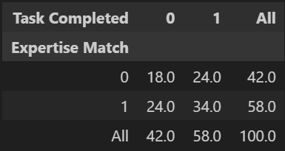
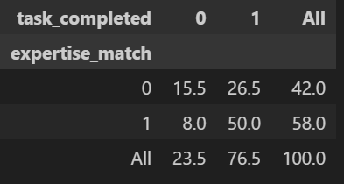
Operational results & impact
BEFORE:
58%
Expertise Match Rate
58% → 76.5%
Task Completion Rate
AFTER:
Faster Job Turnaround
Fewer Errors
More Efficient Use of Workforce
Notes:
“Operationally, the system drove a significant performance lift. Our overall task completion rate increased by 32%, rising from 58% to 76.5%, which directly reflects more accurate technician-task assignments.
Now, the expertise match rate itself remained at 58%, but the quality of those matches improved meaningfully. When a technician was matched on expertise, they were far more likely to complete the task successfully. And when expertise was missing, the system exposed those mismatches more clearly.
Together, this means faster job turnaround, fewer errors, and a much more efficient use of our field workforce.”

Slide 11
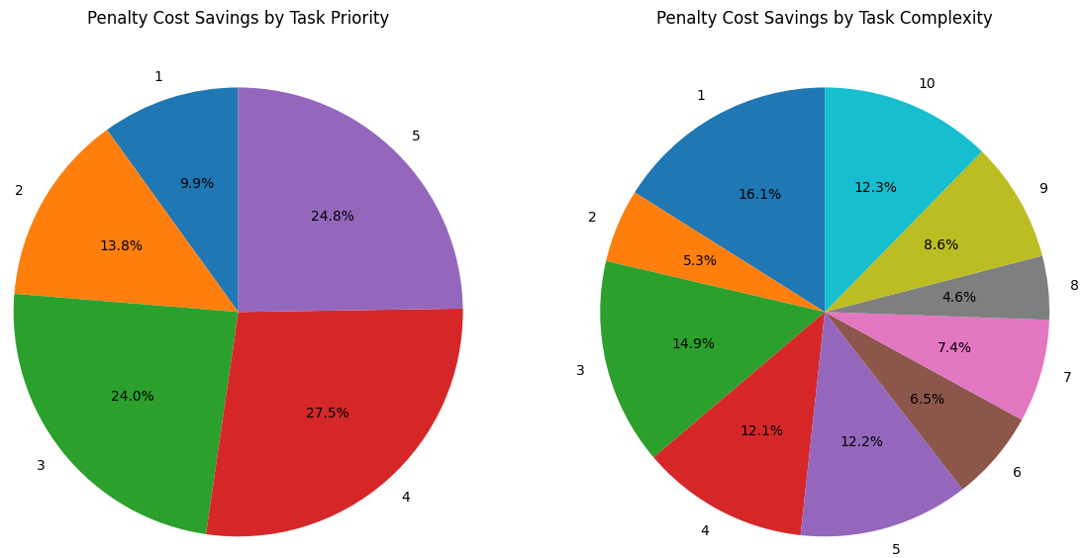
Financial Results & impact
$12.7K
Penalty Cost Savings
Avoid Rework + SLA Penalties
More Efficient Technician Time
Higher Service Margins
Notes:
“One of the clearest indicators of improvement is penalty cost. Today, the organization incurs about $16.8K in avoidable penalties due to misassignments and rework.
With the optimized matching model, that drops to $4.1K—a $12.7K reduction, or a 76% improvement, driven largely by better completion of urgent, high-priority tasks that carry the greatest financial risk.
This creates three meaningful financial benefits:
First, we avoid costly rework—repeat truck rolls, overtime, and SLA fines.
Second, technicians spend less time fixing failed jobs and more time completing billable tasks.
And third, margins improve because the most expensive-to-fail tasks are now resolved correctly the first time.
Altogether, this reduction in penalty cost directly boosts operational efficiency and bottom-line profitability.”

Slide 12
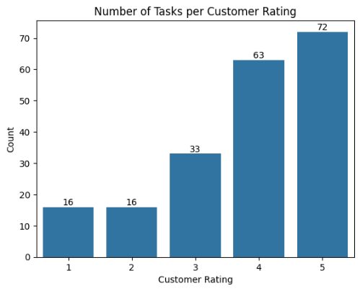
Reputational results & impact
20%
Customer Satisfaction Score
Enhance Reputation
Increases Customer Retention
Become More Competitive
Notes:
“From a reputational standpoint, we also saw a clear improvement in customer experience. The average customer rating increased by 20%, reaching 3.66, and the bar chart shows a noticeable left-skew, meaning more customers are giving higher scores after implementation.
This shift signals stronger customer confidence in service quality and a more consistent experience in the field. Improving satisfaction not only strengthens the company’s reputation, but also increases customer retention and positions the organization more competitively in the telecom market, where reliability is a major differentiator.”

Slide 13
Limitations & future work
Collect More Data
Route Optimization
Account for Dynamic Conditions
Small Dataset
Missing Contextual Data
Challenges with Derived Attributes
Notes:
1 min
“The biggest limitation of this project is the size of the training dataset. With relatively few rows, the model can only learn a limited set of patterns, which increases the risk of overfitting and reduces its ability to generalize to new scenarios.
Another challenge was the lack of deeper contextual data in both Kaggle datasets. Important real-world factors weren’t captured, which limited the precision of engineered fields such as technician complexity and equipment training. As a result, the model performs well with assumptions made, but not as deeply or accurately as it could with richer operational data.
Looking ahead, the most impactful improvement would be expanding data collection directly from the live service platform. Adding route optimization, and incorporating dynamic conditions—like sudden outages, demand spikes, or technician availability—would significantly strengthen the model and make scheduling smarter, faster, and more adaptive to real-world complexity.”

Slide 14
Business recommendations
Change Management Plan
Employee Trainings
Notes:
30 sec
“The Automated Technician Task Matching System is not just a tool—it’s an opportunity to transform how the organization delivers field service. By leveraging data-driven assignments, we can reduce costs, improve task success, and ensure a more consistent, high-quality experience for every customer.
To fully capitalize on this, I recommend a structured implementation plan: start with a pilot in one region, provide targeted training and change management for technicians and dispatch teams, and incorporate their feedback to refine workflows. Coupling this with continuous data integration and real-time updates will make the system adaptive, resilient, and aligned with operational realities.
With these steps, this solution can set a new benchmark for efficiency, reliability, and customer satisfaction in the telecommunications industry—turning data insights into measurable business impact and positioning the company as a leader in intelligent, industry-aligned field service.”
Thank you all for staying and listening. Please reach out if you have any questions.

